Slide 1
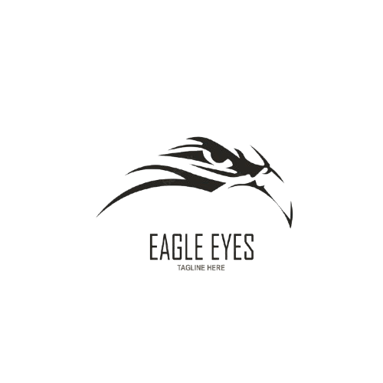
CS 440 (Group 4) - Implementation Project
HawkEye
HawkEye
YOUR HUNT ENDS HERE
Ashton Edakkunnathu, Jay Patel, Manan Patel,. Lena Tran
Notes:
Lena:
Hello everyone! Today we will be introducing you to SubterraView.

Slide 2
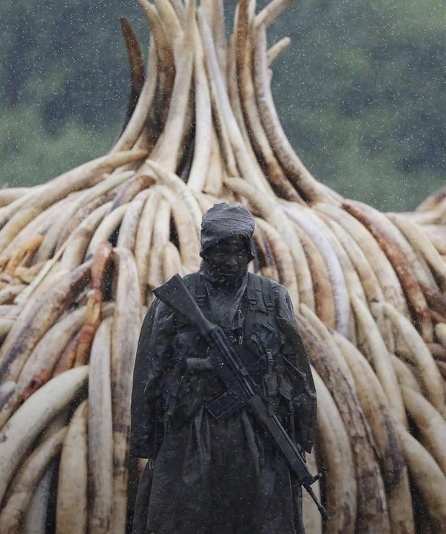
The Problem
Poaching is a billion-dollar industry that kills tens of thousands of animals every year
Manual wildlife tracking is costly, slow, and limited in coverage for researchers + conservationalists
No existing solution combines real-time monitoring, AI detection, and threat response in one system
Kenyan anti-poaching ranger with confescated ivory
2
Notes:
Wildlife conservation is facing a serious crisis. Poaching alone kills tens of thousands of animals every year, and it's a problem that's only getting harder to fight. The tools conservationists and researchers currently rely on — things like stationary cameras and manual patrols — are slow, expensive, and can only react after something has already gone wrong. On top of that, researchers trying to study animal behavior have no efficient way to monitor large areas in real time. There's simply no single system that brings together live monitoring, AI-powered detection, and threat response. That's the gap Hawkeye was built to fill.

Slide 3
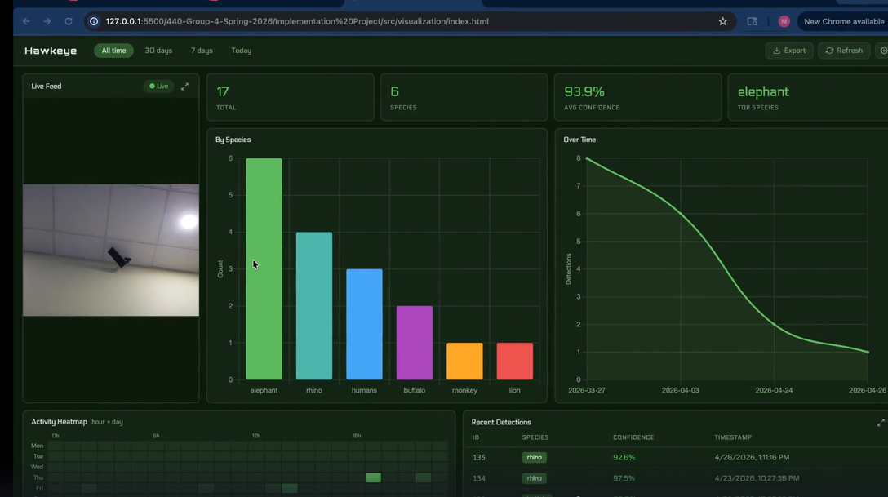
HawkEye Overview
A drone system that uses AI to detect and identify animal species in real time
Streams live video from a Raspberry Pi camera to a web dashboard
Logs every detection with species, confidence score, and timestamp to the cloud
One unified platform for live monitoring and historical data analysis
3
Notes:
So what is Hawkeye? At its core, Hawkeye is a drone-mounted AI system that detects and identifies animal species in real time as the drone flies over an area. It streams live video directly from a Raspberry Pi camera to a web dashboard that anyone on the same network can access. Every detection gets automatically logged to the cloud with the species name, confidence score, and timestamp — no manual entry needed. The result is one unified platform where researchers and conservationists can monitor wildlife live and dive into historical data all in one place.

Slide 4
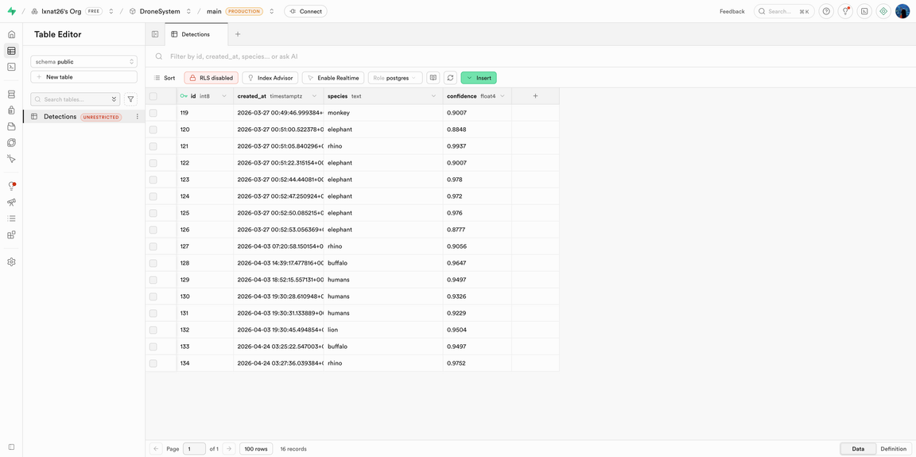
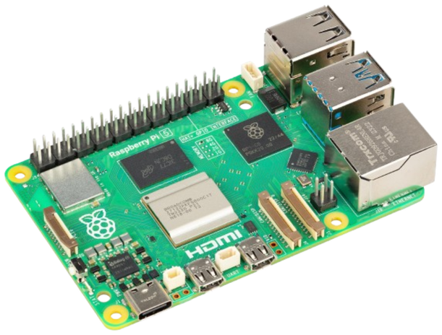
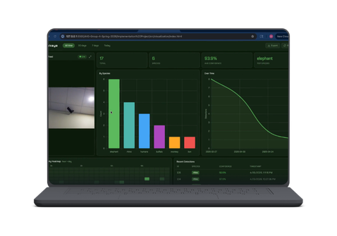

System Architecture
Raspberry Pi
Camera Stream
Laptop
AI Detection + Dashboard
Supabase
Cloud DB
4
Notes:
Hawkeye runs across two devices. The Raspberry Pi is mounted on the drone and streams live video over Wi-Fi using Flask. That stream is picked up by a laptop, which runs our YOLOv8n convolutional neural network on every incoming frame to detect and identify animals in real time. The model also assigns each detected animal a unique tracking ID across frames, so the same animal is never counted twice. Only detections that hit our 85% confidence threshold get logged — keeping our data clean and minimizing false positives. Those confirmed detections get pushed instantly to our Supabase cloud database with the species name, confidence score, and timestamp. Two devices, one seamless pipeline.

Slide 5
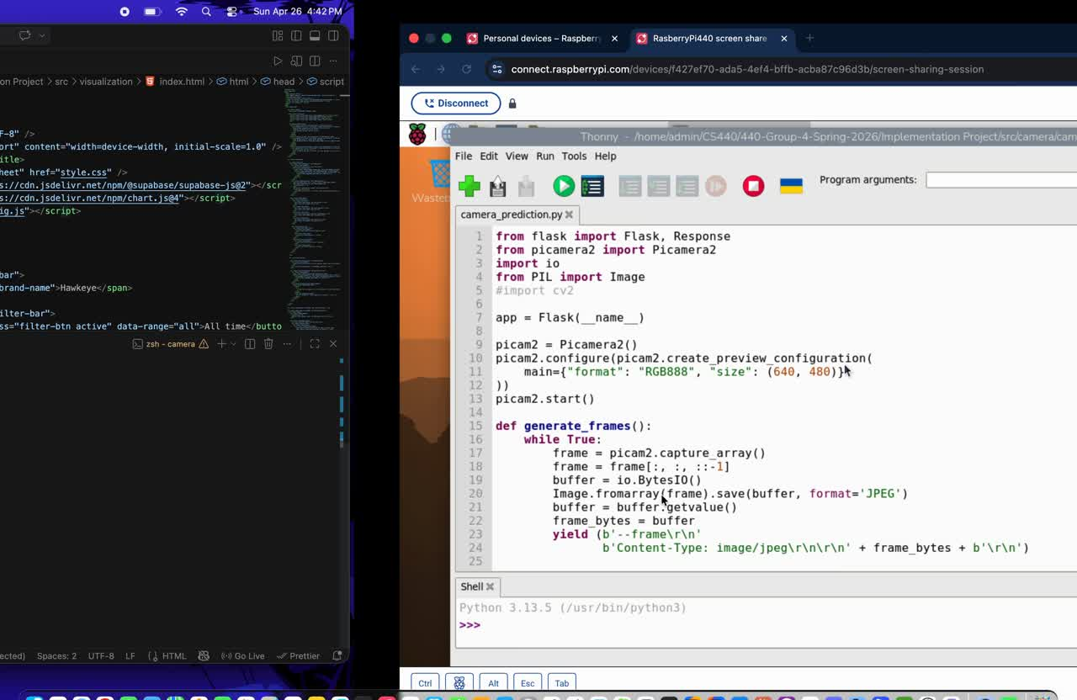
Demo
5
Notes:
Here's Hawkeye in action. On the left is the live feed streaming directly from the drone. As detections come in, the dashboard updates automatically in real time — no refresh needed. You can see we're tracking 16 total detections across 6 different species with an average confidence of 94%. The bar chart breaks down detections by species, and the line chart shows activity trends over time. Below that, the heatmap shows when detections are most frequent by hour and day. Every detection is also logged in the bottom right with its species, confidence score, and timestamp — fully filterable and exportable as a CSV

Slide 6
Closing Thoughts
A real-time AI pipeline across hardware, cloud, and dashboard was our biggest challenge
We achieved human detection as a first step toward our anti-poaching vision
Next step would be triggering real-time alerts to authorities when humans are detected
6
Notes:
Building Hawkeye taught us a lot. Getting a real-time AI pipeline working across hardware, a cloud database, and a live dashboard was honestly more challenging than we anticipated. One thing that really helped was designing the system modularly from the start — keeping each layer separate made everything easier to build and debug. We did achieve human detection, which is a meaningful first step toward the anti-poaching vision we outlined in our design. Given more time, we'd build on that foundation to trigger real-time alerts to authorities when humans are detected in protected areas. Overall Hawkeye is a proof of concept that shows how accessible drone and AI technology can make a genuine difference in wildlife conservation.

Slide 7
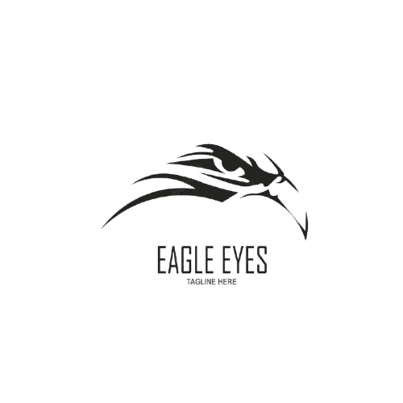
Thank You
FOR LISTENING =)
Notes:
Thanks!

